Slide 1

Presentation of Module 3
The Relationship Between Use of Public Transport and Residential or Commercial Zones
Davi Guggisberg, Maria Mumtaz, Corinna Rutschi
CAS in Applied Data Science
University of Bern
December, 21 2021

Slide 2

Problem Statement
To what extent is the number of employees in a zone related to other variables in that zone?
What is the number of travel cards in a zone?
#1
#2
Should we rephrase the questions here? Mostly for number 2?

Slide 3
Main Dataset
NPVM Data (Nationales Personenverkehrsmodell) - Open Data
7752 zones
154 features:
Zone information | Population | Employment | Daily visits | Travel card subscription
6 features | 115 features | 10 features | 18 features | 5 features

Slide 4
Data Cleaning and Evaluation
Merge data subsets
Rename columns
Remove some records
Remove redundant features

Slide 5
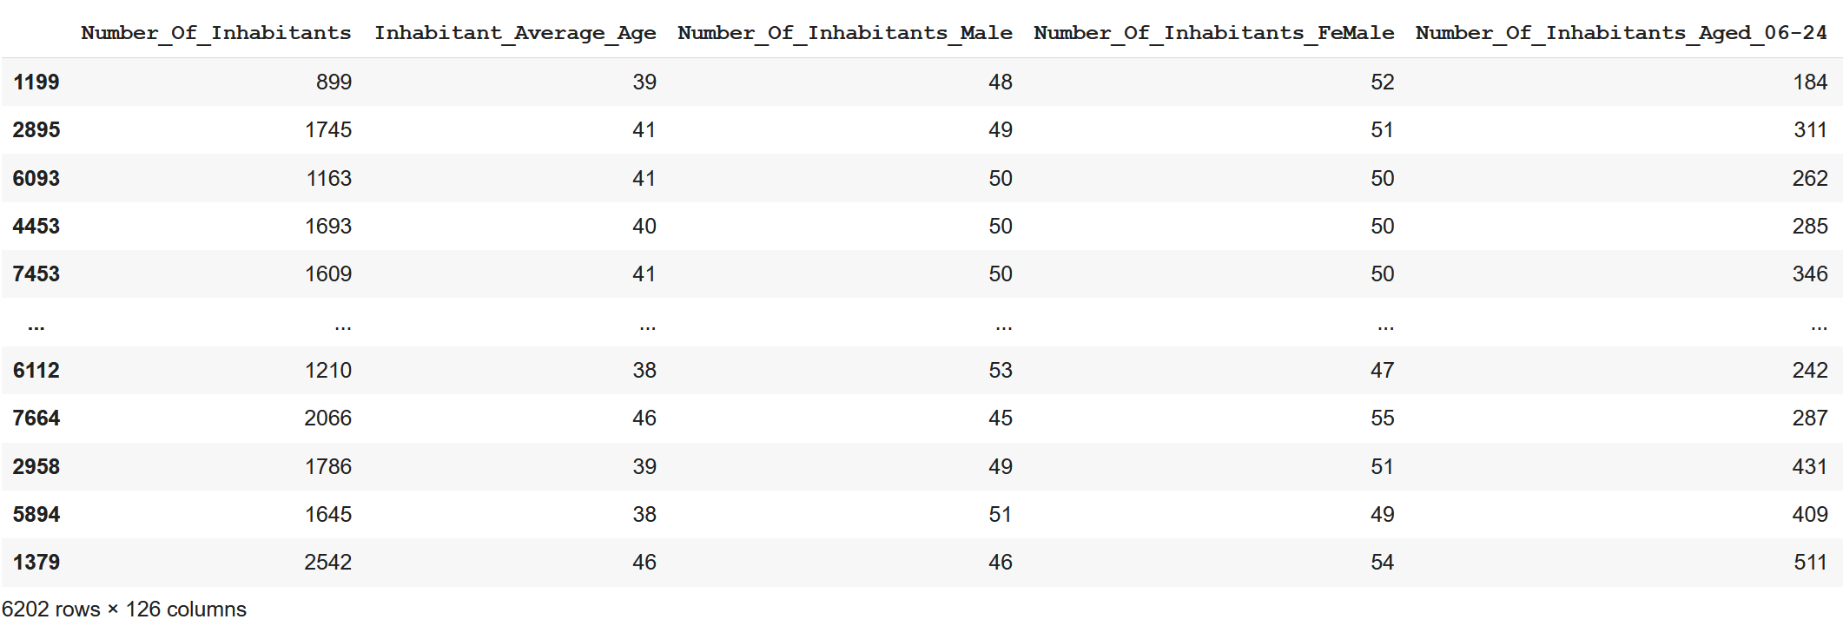
Making Data Numeric
128 numberic features
6202 zones

Slide 6
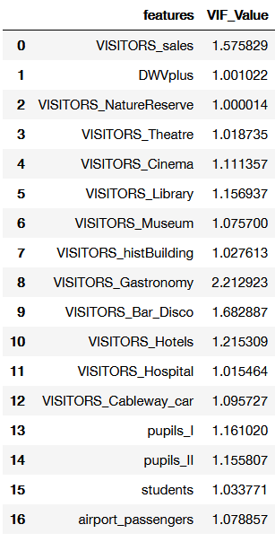
Variance Inflation Factor
#1
Goal: Get rid of multicollinearity
Dependent variable: number of employees (sum_e)
Iterations: 3
Outcome: 16 remaining independent variables
Notes:
It’s called the variance inflation factor because it estimates how much the variance of a coefficient is “inflated” because of linear dependence with other predictors.
A VIF of 1.8 tells us that the variance (the square of the standard error) of a particular coefficient is 80% larger than it would be if that predictor was completely uncorrelated with all the other predictors.

Slide 7


Multilinear Regression
#1
Goal: Test relation of number of employees with other variables
Multilinear Regression with the identified 16 variables
Multilinear Regression including 16 variables + VISITORS_Leisure, VISITORS_Fitness, and VISITORS_Sports
Notes:
It’s called the variance inflation factor because it estimates how much the variance of a coefficient is “inflated” because of linear dependence with other predictors.
A VIF of 1.8 tells us that the variance (the square of the standard error) of a particular coefficient is 80% larger than it would be if that predictor was completely uncorrelated with all the other predictors.

Slide 8
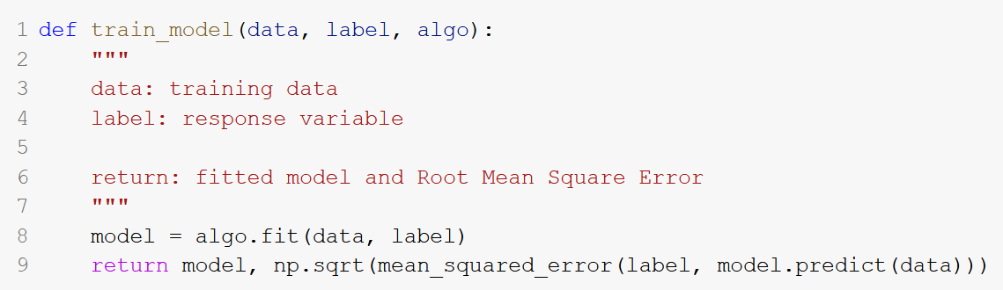
Linear Regression & Random Forest
#2
Goal: Predict number of subscriptions per zone
Dependent variable: total number of subscriptions
Function:
Results of linear regression:
Linear regression with all numeric features RMSE: 356.2 R2 score: 0.0165
Results of random forest:
andom forest with all numeric features RMSE: 137.5 R2 score: 0.85

Slide 9
Cross Validation
#2
So far: Predictions based on whole training set 🡪 not very helpful because the model is tailored for the training data
It's hard to tell whether the model will generalize well on unseen test data
Test set can only be used once 🡪 how do we further check if random forest is truly better?
Next step: use cross validation, 10-fold cross validation
K-fold cross validation:
partition of the dataset into K random parts
iterate through each part, training on the rest and testing again
average the performance metric across all iterations for the cross-validation score
Conclusion:
RMSE is higher than it was previously. This makes sense because in k-fold cross validation each fold is treated as if it was an unseen test set so we can avoid over fitting.
It should be noted that, when the dataset is large, k-fold validation can be very slow. 10-fold validation means we train the model 10 times.

Slide 10
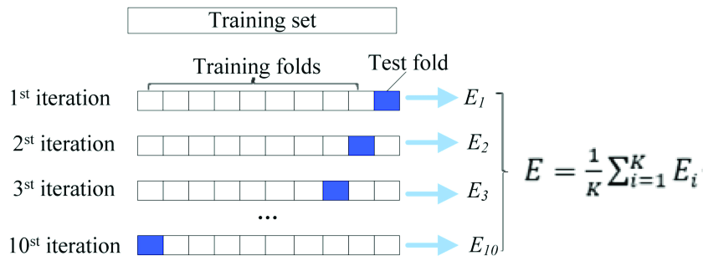
Cross Validation of Linear Regression
#2
Goal: Validation of models for linear regression using 10-fold cross validation
Results:
RMSE from 10 fold cross validation: [340.4, 352.1, 360.6, 374.4, 403.2, 337.6, 364.2, 362,
392, 350.2]
RMSE Mean: 363.7
RMSE Standard deviation: 20.06

Slide 11
Cross Validation of Random Forest
#2
Goal: Validation of models for random forest using 10-fold cross validation
Results:
RMSE from 10 fold cross validation: [343, 354.4, 363.8, 376.6, 409.2, 350.6, 366.4, 366.6,
393.3, 359.1]
RMSE Mean: 366.3
RMSE Standard deviation: 19
 | Linear Regression | Random Forest
RMSE | 356.2 | 137.5
R2 score | 0.0165 | 0.85
Cross validation RMSE | 363.7 | 366.3

Slide 12
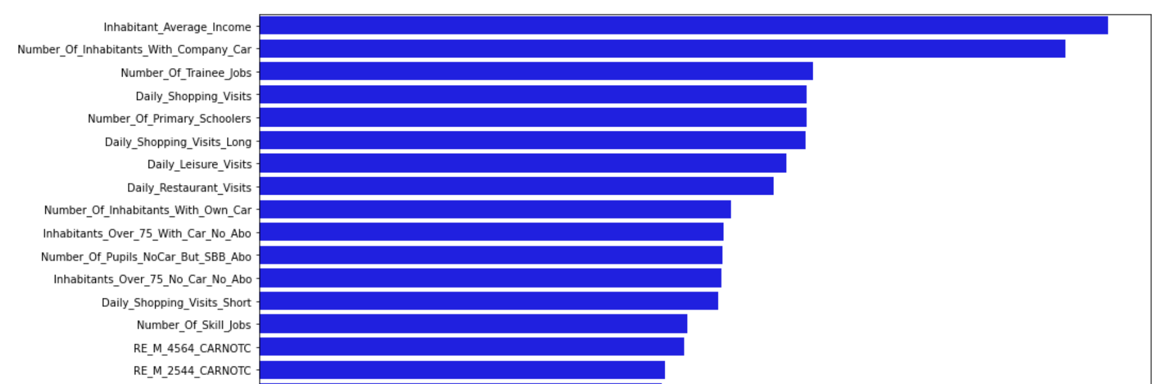
Feature Importance
#2
Goal: Estimate importance of features
Results
Random forest with reduced number of features RMSE: 137.8

Slide 13
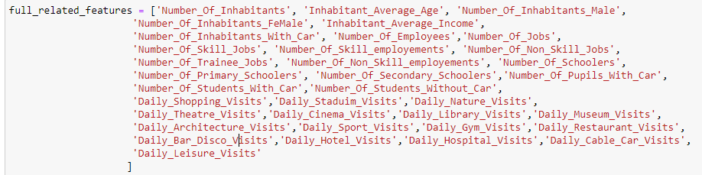

Slide 14
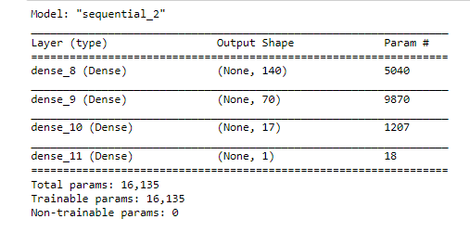
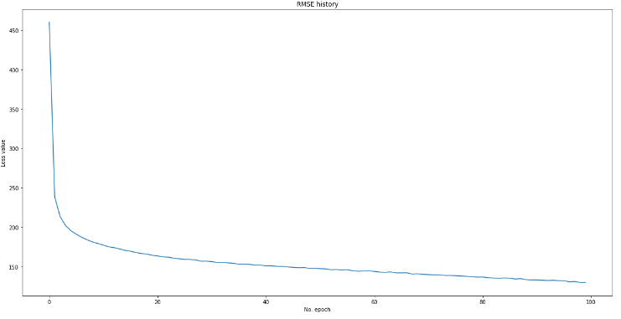
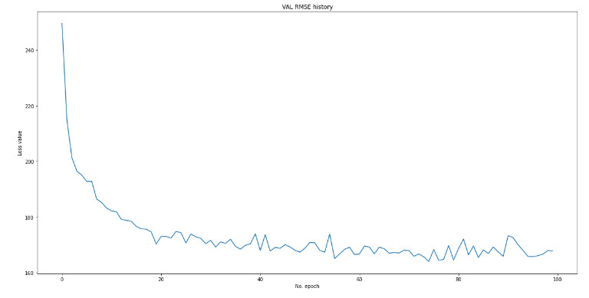
Simple Neural Network
Goal:
Predict number of subscriptions per zone based on:
Infrastructure elements
Accessibility and commute
Demographics
Train RMSE: 129.7 Validation RMSE: 167.8 R2 score: 0.739

Slide 15
Data Preparation for Image-based Prediction
#2
Hypothesis: Spatial distribution inside the zones could help prediction
Heatmaps: a way to feed "spatial distribution" to an algorithm in the most direct way
Data format:
Independent variables: Images of 128x128 pixels
43 features: one heatmap per binary spatial feature (e.g., people, students, GA-holders, etc.)
Dependent variables: Number of subscriptions
Model: CNN (best model for image processing)
Normalization: images not normalized, i.e. densest zone is also the brightest

Slide 16
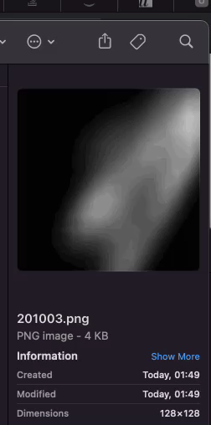
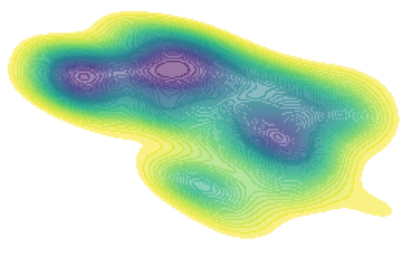
Data Preparation for Image-based Prediction
#2

Slide 17
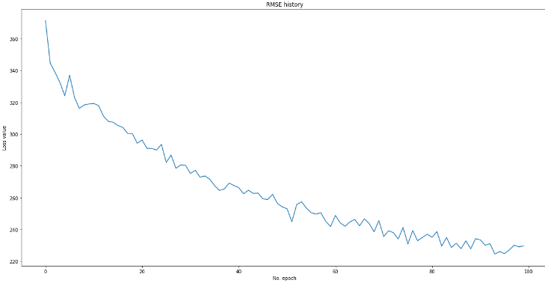
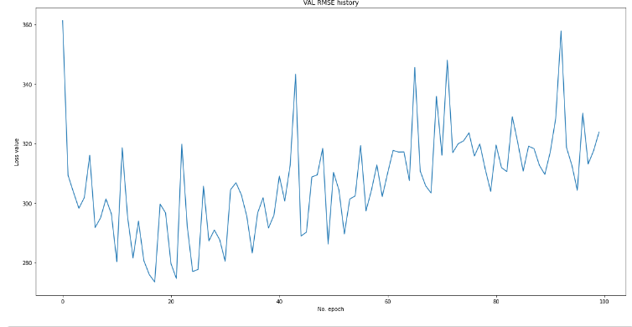
Convolutional Neural Network
CNN
128x128 (image) x 43 (f.) x 7978 (zones)
2 Conv2d layers
MaxPooling, Dropout, …
Results
RMSE validation: 275 / 320
-> better than linear regression
but inferior to others.

Slide 18
Summary of Results
To what extent is the number of employees in a zone related to other variables in that zone?
Identify important features using VIF
Multilinear regression based on number of employees
Number of travel cards prediction
Linear regression and random forest
K-fold cross validation
Feature importance
Simple neural network
Image-based / spatial distribution prediction with CNN
Image generation
Best model: Random Forest with R2 at 0.85
Future work / partially explored possibilities
OD-Matrix estimation with random forest
Clustering of the zones

Slide 19
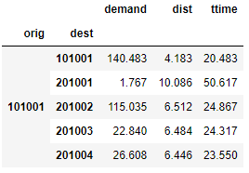
Future Work: OD-Matrix Estimation with Random Forest
#2
Basic data:
Zonal data (Origin + Destination):
Residents
Employed population
Population by age groups
Student / pupil population
Number of PT travelcard subscriptions
Average income
Number of jobs
Totals of shopping visitors
School / university places
…

Slide 20
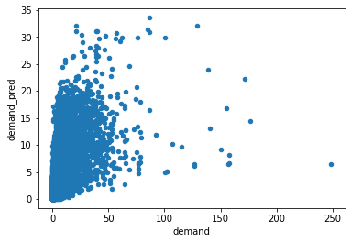
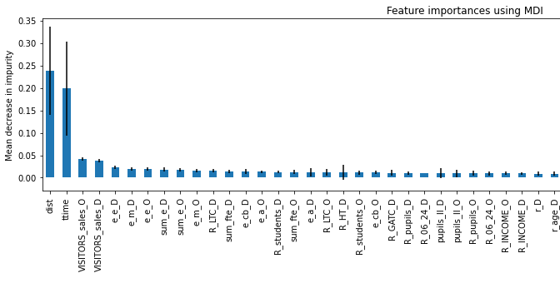
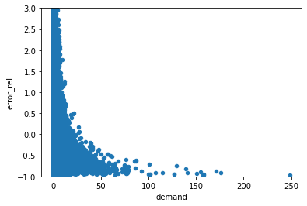
Future Work: OD-Matrix Estimation with Random Forest
#2
Goal: Predict PT travel demand
Scores (R2): 0.57 / 0.53
Feature importance (subset):
Errors:

Slide 21
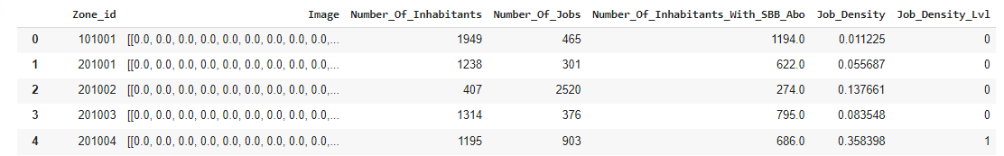
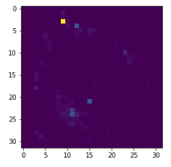
Future Work: Clustering
#1
Goal: Clustering of zones with high, medium and low job density level
Applying PCA to all columns to have a (x,y) point output for
each row
K-Means Clustering where K is set to 3

Slide 22
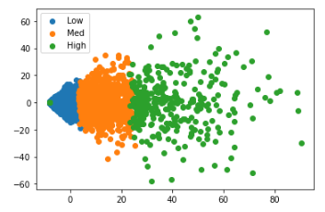
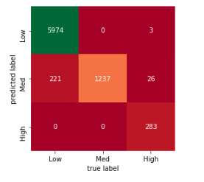
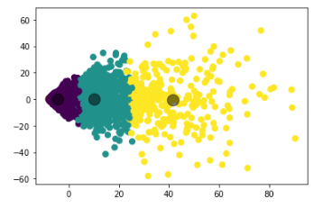
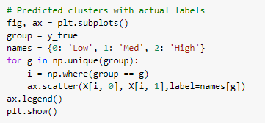
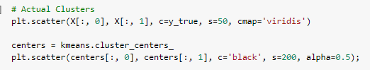
#1

